Slide 1
Coherent control of non-Markovian photon-resonator dynamics
A.F.J. Levi
University of Southern California
Presented at the Paul Scherrer Institute, March 5, 2018

Slide 2
“Coherent control of photons”
Coherent
  Keep track of amplitude, phase, and maintain precise timing within a characteristic length or time scale
  Control
    Methods to modify the behavior of a system with one or more inputs
  Photon
    A wavelike particle of energy that produces a click on a detector
… and, there may be additional opportunities with quantum aspects of photons
Quantum
  No accepted measure of “quantumness”
  Classical analogies often exist (e.g. the coherent oscillator state) except for:
    Wave-particle duality
    Identical indistinguishable particles
    Linearity
    Entanglement

Slide 3
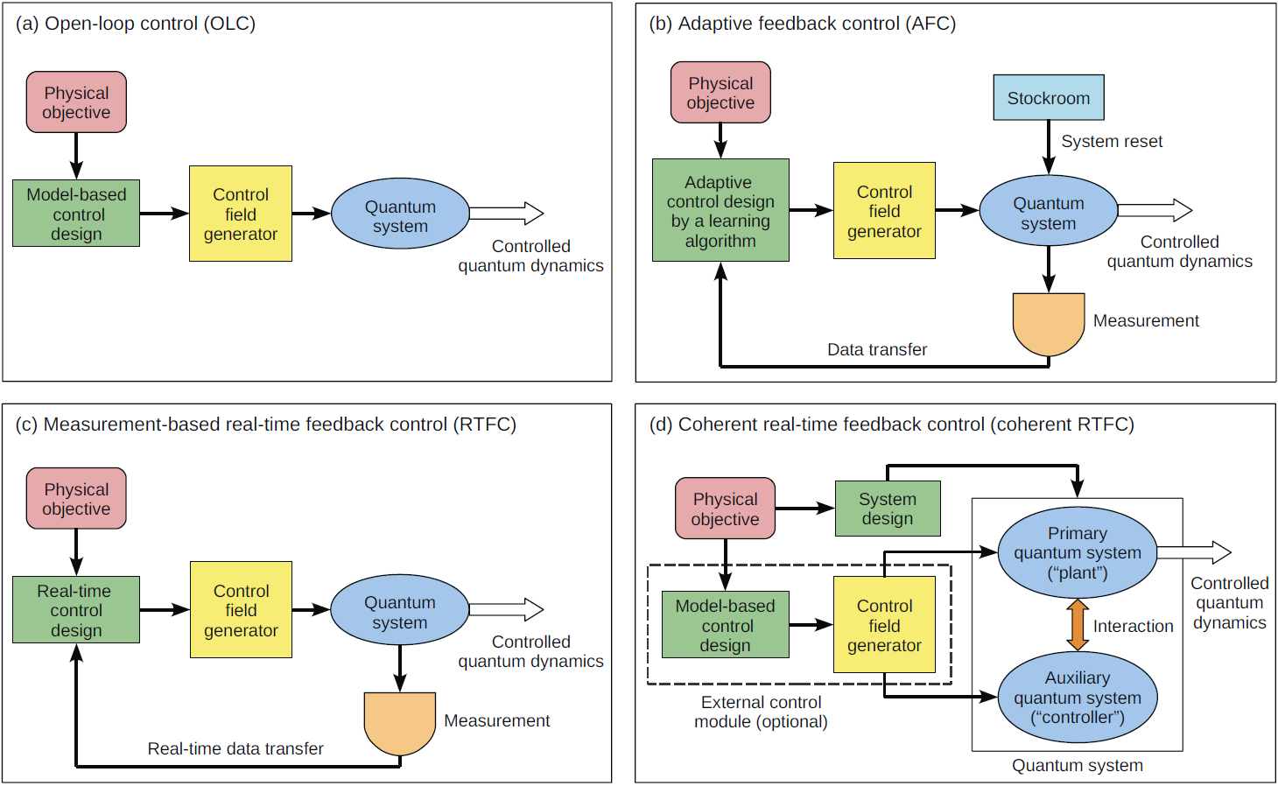
Motivation: Demonstrate a path to intuitive control of transient photon dynamics (in quantum systems)
Control field generator
System
Modified from Rabitz et al., 2010: General unifying features of controlled quantum phenomena: https://arxiv.org/pdf/1003.3506

Slide 4
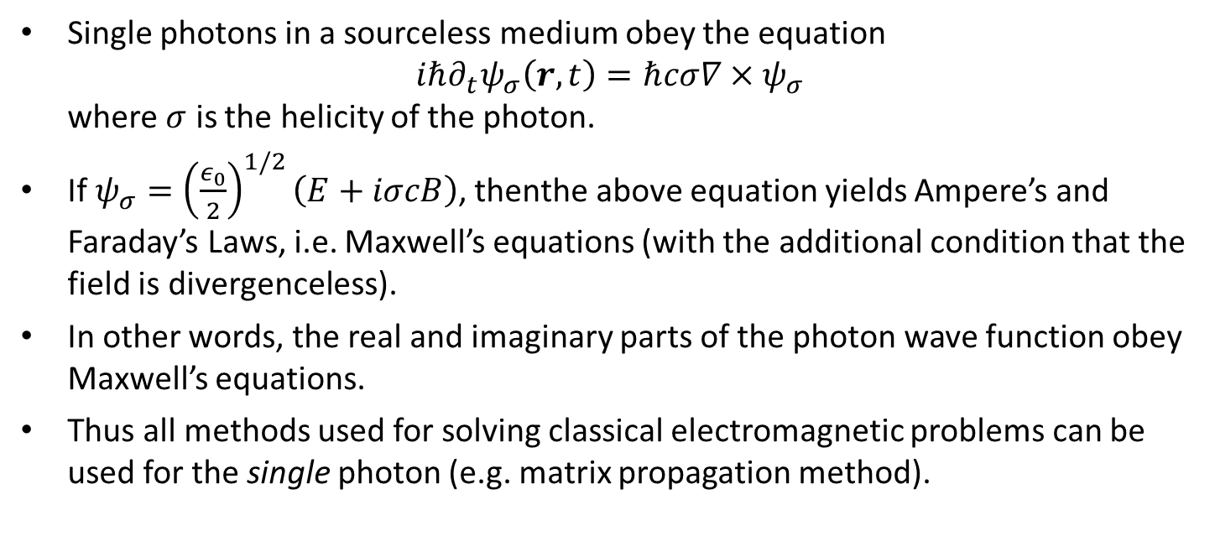
The single photon wave function
Single photons in a sourceless medium obey the equation
$iℏ∂_{t}ψ_{σ}\left(r,t\right)=ℏcσ∇×ψ_{σ}$
where $σ$ is the helicity of the photon.
If $ψ_{σ}={\left(\frac{ε_{0}}{2}\right)}^{1/2}\left(E+iσcB\right)$, thenthe above equation yields Ampere’s and Faraday’s Laws, i.e. Maxwell’s equations (with the additional condition that the field is divergenceless).
In other words, the real and imaginary parts of the photon wave function obey Maxwell’s equations.
Thus all methods used for solving classical electromagnetic problems can be used for the single photon (e.g. matrix propagation method).

Slide 5
The single photon wave function
It is (now) believed that a single photon wave function may be used to describe photon energy density U(x,t)=|Ψ(x,t)|²
  Studied theoretically, including
    I. Bialynicki-Birula, Acta Phys. Pol. 86, 97 (1994)
    B. J. Smith and M. G. Raymer, New Journal of Physics 9, 414 (2007)
Unitary dynamics of photon wave function propagating in x-direction in lossless dielectric media may be modeled as phase-coherent sum of linearly polarized plane-wave basis functions, each of amplitude a_{n} and oscillating at frequency ω_{n}
The lossless dielectric material may be characterized by μ_{r} and ε_{r} , and ψ_{n} satisfies
with boundary conditions between region 1 and 2 at position x₀ such that
and refractive index
Solve in space and time and assume photon coherence time, τ_{Coh}, greater than any other characteristic time

Slide 6
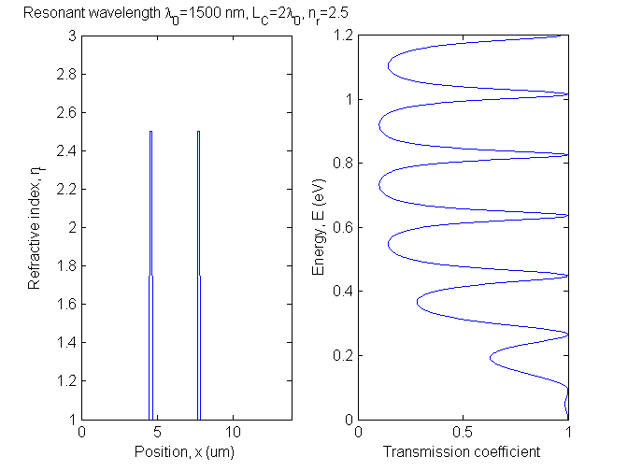
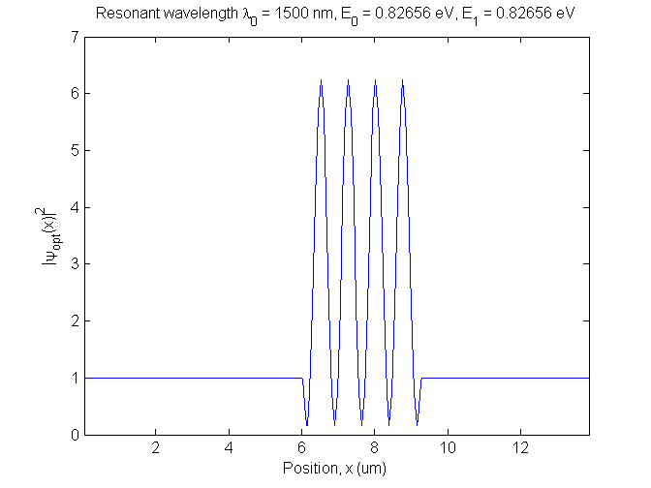
The Fabry-Perot optical resonator
Example dielectric structure: Two quarter-wave dielectric mirrors with n_{r}=2.5 spaced L_{C} =2λ₀ apart creates Fabry-Perot optical resonator that is coupled to the continuum
Resonant wavelength λ₀=1500 nm, ω₀=2π/τ₀=2πx200 THz, τ₀=5 fs
Resonant photon energy E₀=0.826 eV
Q=ω₀/γ, Lorentzian spectral FWHM=h/τ_{Q}, γ=1/τ_{Q}
Classical time-domain response is and τ_{Q} is resonant state lifetime
Resonator round-trip time defined as τ_{RT}=2π/Δω=1/Δf where Δf is the frequency spacing between adjacent spectral transmission peaks
FWHM

Slide 7
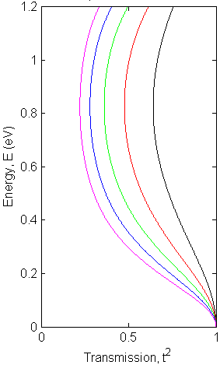
Reflectivity of single quarter-wave dielectric mirror
Example dielectric structure: Single quarter-wave dielectric mirror with n_{r}=2.5
Resonant wavelength λ₀=1500 nm, ω₀=2π/τ₀=2πx200 THz, τ₀=5 fs
Resonant photon energy E₀=0.826 eV
Transmission is a slowly varying function of photon energy,
On resonance , , , so that
System requires
t² = r² = 1/2 when
For field and
t and t² less dependent on photon energy as:
  π phase shift on reflection from semi-infinite slab,
n_{r}=2.5
n_{r}=2.0
n_{r}=4.0

Slide 8
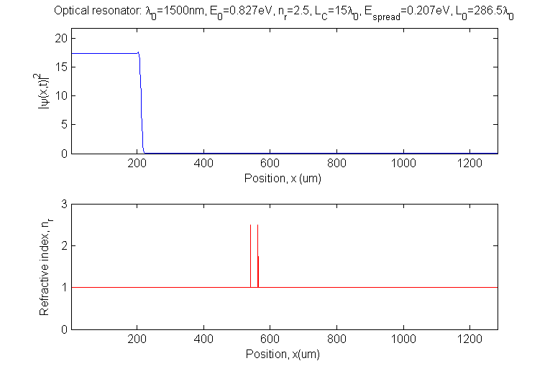
Transient response of single-photon (or classical E&M) pulse incident on Fabry-Perot cavity at resonance
Rectangular photon pulse with center frequency that is on resonance at wavelength λ₀=1500 nm, ω₀=2π/τ₀=2πx200 THz, τ₀=5fs
Quarter-wave (λ₀/4n_{r}) dielectric mirror with n_{r}=2.5, cavity length L_{C}=15λ₀, cavity round-trip time τ_{RT}=2π/Δω=30τ₀=150fs
Q=193, τ_{Q}=Q/ω₀=153fs
Rectangular photon pulse of length L_{P}=286.5λ₀ (τ_{p}=1432fs) and center frequency f₀ = 200 THz (τ₀=5fs) propagating from left to right
Fabry-Perot dielectric resonator, L_{C}=15λ₀, τ_{RT}=150fs, τ_{Q}=153fs
τ₀ =5fs
τ_{p} =1432fs
τ_{RT}=150fs
τ_{Q} =153fs

Slide 9
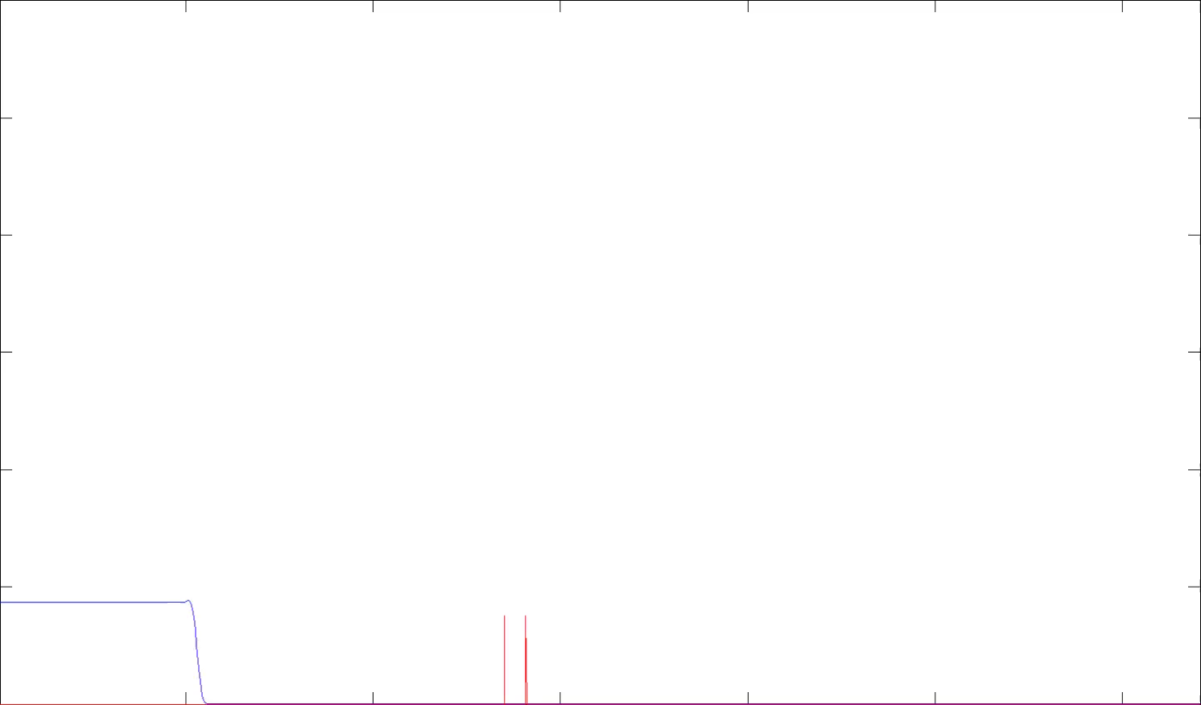
Transient response of single-photon pulse incident on Fabry-Perot cavity at resonance
When photon round-trip time in resonator τ_{RT} is comparable to envelope response time τ_{Q} it is possible to probe the internal (ring-down) structure of the resonator
Photon energy density, |Ψ(x,t)|²
τ₀ =5fs
τ_{p} =1432fs
τ_{RT}=150fs
τ_{Q} =153fs
0
200
400
600
800
1000
1200
Position, x(μm)

Slide 10
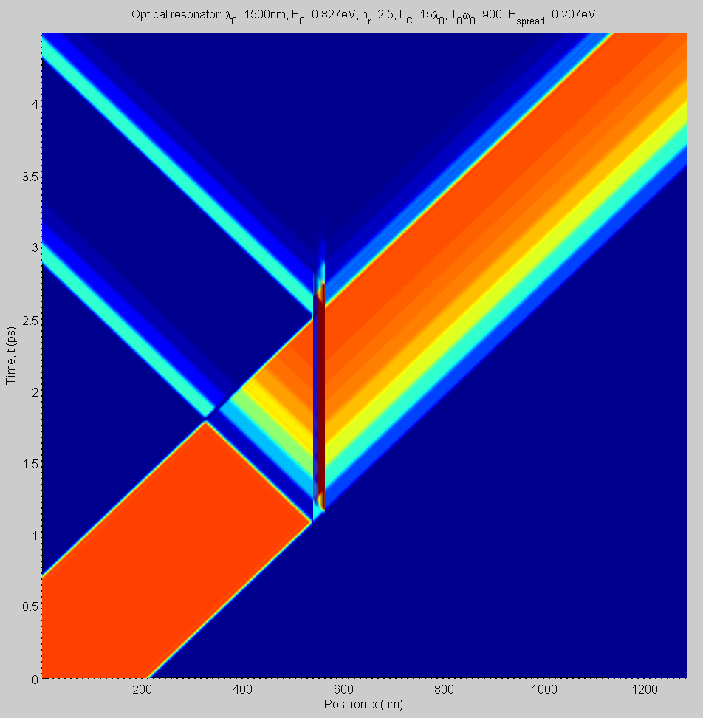
Transient response of single-photon pulse incident on Fabry-Perot cavity at resonance
Reflection from trailing edge with step-wise τ_{RT} ring-down and exponential τ_{Q} envelope
Transmitted photon pulse with step-wise τ_{RT} features and exponential τ_{Q} envelope
Reflection from leading edge with step-wise τ_{RT} ring-down and exponential τ_{Q} envelope
Time
Position of Fabry-Perot resonator L_{C}=15λ₀
Incident photon pulse of length L_{p}=286.5λ₀ in free-space
τ₀ =5fs
τ_{p} =1432fs
τ_{RT}=150fs
τ_{Q} =153fs
Space

Slide 11
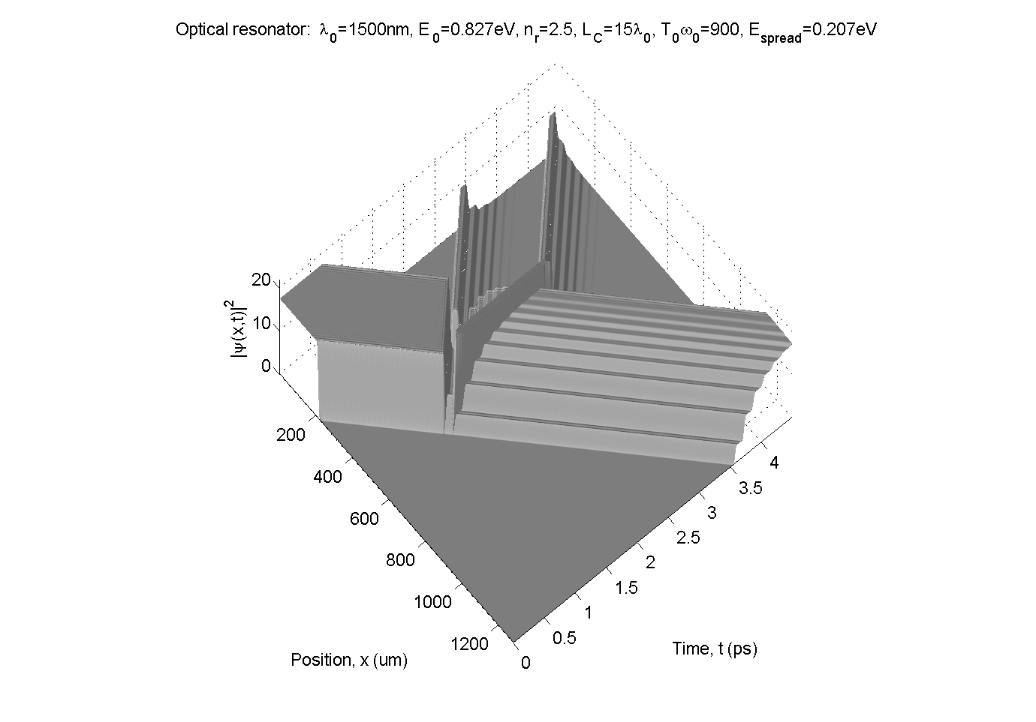
Transient response of single-photon pulse incident on Fabry-Perot cavity at resonance
Multiple cavity round-trip times required to build-up steady-state behavior
Rectangular photon pulse with center frequency that is on resonance has characteristic transient reflection at leading and trailing edge
  Reflection depends on frequency components contributing to pulse shape
  Reflection always greater than zero for pulse
Burst of reflected light from trailing edge of pulse
Burst of reflected light from leading edge of pulse
No reflected light at resonant wavelength
τ₀ =5fs
τ_{p} =1432fs
τ_{RT}=150fs
τ_{Q} =153fs

Slide 12
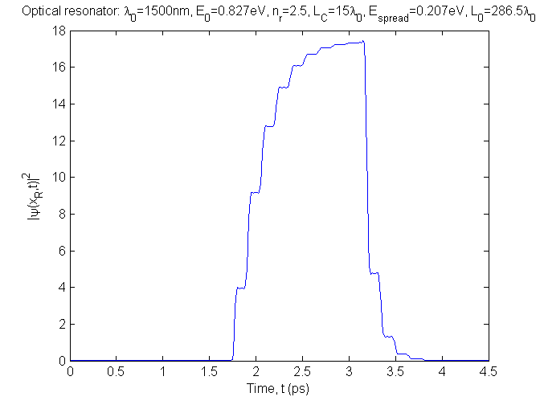
Transient response of single-photon pulse incident on Fabry-Perot cavity at resonance
Calculated transmitted single-photon energy density, |ψ(x_{R}, t)|² at x_{R}=742.8μm
Characteristic step-wise build-up of resonant state. Step width τ_{RT} and exponential increase in |ψ(x_{R},t)|² envelope with time constant τ_{Q}.
τ₀ =5fs
τ_{p} =1432fs
τ_{RT}=150fs
τ_{Q} =153fs

Slide 13
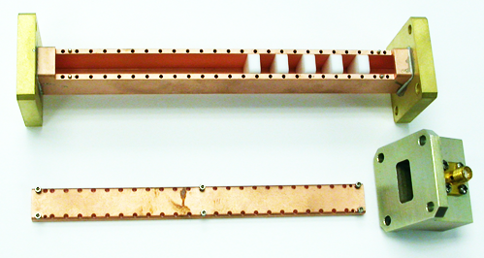
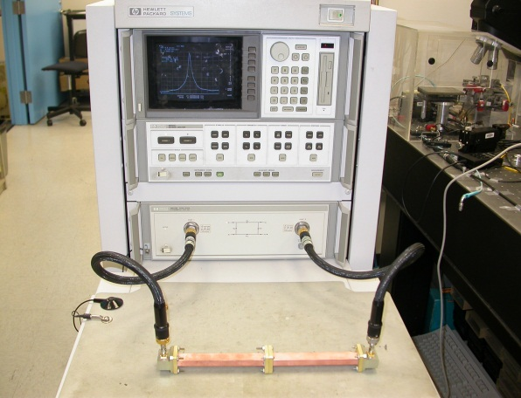
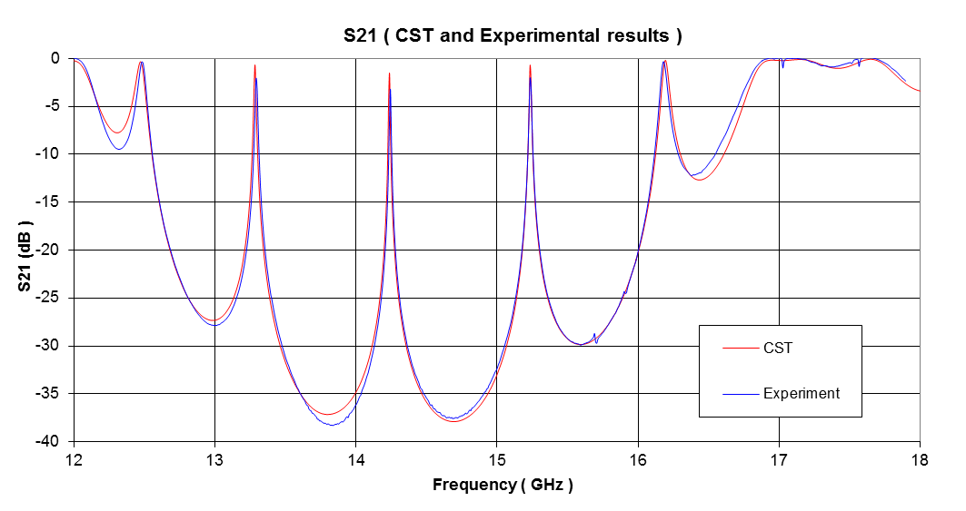
Experimental validation using Fabry-Perot resonator in waveguide
Because equations governing single-photon wave function evolution are similar to the Helmholtz equation, experiments using classical electromagnetic resonators can validate qualitative behavior.
Example:
  Resonant frequency, f₀=15.234 GHz (E₀=63 μeV)
  Measured permittivity of teflon, ε_{r}=2.050
  Measured loss tangent, δ=0.0005
DBR mirror
FWHM
Resonant transmission
peak
Δf=1/τ_{RT}
13

Slide 14
Experimental validation using Fabry-Perot resonator in waveguide
Measured transmitted electromagnetic energy density in time-domain U(t) (|mV|² into 50Ω)
Resonant frequency, f₀=8.0620 GHz (E₀=33 μeV)
  1/25,000 scale reduction in frequency from optical to RF
3 quarter-wave pair DBR in teflon
Round-trip time in resonator τ_{RT}=12 ns
Resonator Q=582 corresponds to τ_{Q}=11.5 ns (red curve)
Long pulse time τ_{p}=230ns >> τ_{RT}, τ_{Q}
fileB4.xlm
fileB2.xlm

Slide 15
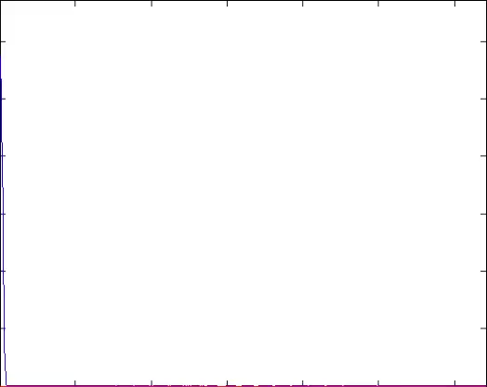
Uncontrolled short single-photon pulse in cavity ring-down
Multiple reflected and transmitted photon energy density pulses (ring-down)
L_{C}
-t²r⁴
Time
t²r³
itr⁴
Photon energy density, |Ψ(x,t)|²
-itr³
-t²r²
t²r
itr²
-itr
-t²
0
200
400
600
800
1000
1200
Position, x(μm)
it
Identical lossless dielectric mirrors m_{r} with complex field reflectivity r and transmission t
π phase shift on reflection of incident field
Resonant photon field in resonator is geometric series (1+re^{iφ}+r²e^{i2φ}+r³e^{i3φ} + …)=1/(1-re^{iφ}) where phase per round-trip is 2φ=2πω/Δω and spacing between resonances is Δω=πc/L_{C}n_{r}
-r
τ₀ = 5 fs
τ_{p} = 80 fs
τ_{RT}= 150 fs
τ_{Q} = 153 fs
m_{r}
m_{r}
1
Incident photon pulse energy density
Space
Notes:
15

Slide 16
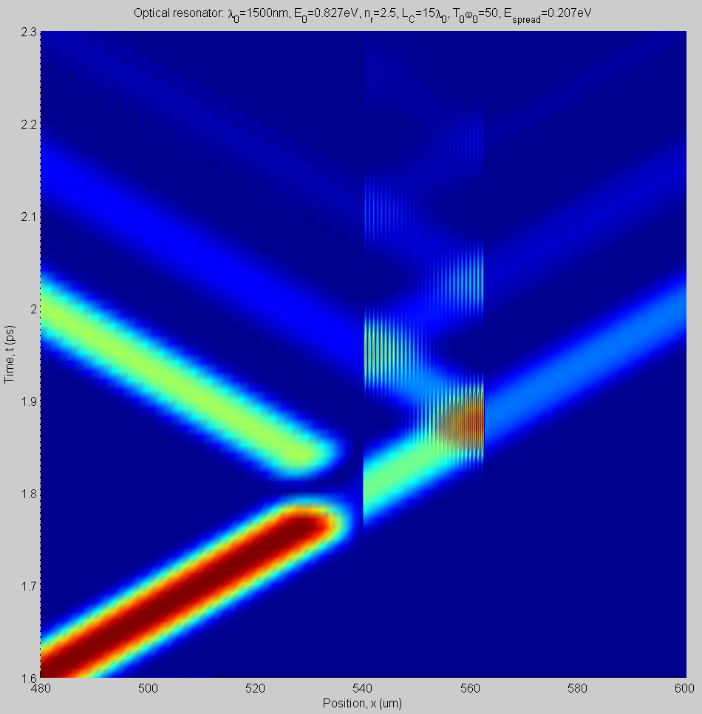
Uncontrolled single-photon cavity ring-down
Multiple reflected photon energy density pulses (ring-down)
Multiple transmitted photon energy density pulses (ring-down)
Time
τ₀ = 5 fs
τ_{p} = 80 fs
τ_{RT}= 150 fs
τ_{Q} = 153 fs
Incident photon pulse energy density
Spatial extent of Fabry-Perot resonator that stores and releases photon energy density is L_{C}=15λ₀
Space

Slide 17
Experimental validation using Fabry-Perot resonator in waveguide
Can also probe the internal structure of the Fabry-Perot resonator using short electromagnetic pulse time τ_{p}=7 ns < τ_{RT}, τ_{Q}
Round-trip time in resonator τ_{RT}=13.7 ns
Resonator Q=633 corresponds to τ_{Q}=12.5 ns (red curve)
RF switch rise time is 2 ns
Measured transmitted electromagnetic signal in time-domain |mV| into 50 Ω
To high-speed oscilloscope
Synthesizer frequency f₀ with τ_{Cho}>>{τ_{Q}, τ_{RT} }
High-speed switch
Waveguide Fabry-Perot resonator
τ_{Q}, τ_{RT}
DBR
DBR
f₀ = 8 GHz
τ_{Coh} = 1 s
τ₀ = 125 ps
τ_{p} = 7 ns
τ_{RT} = 13.7 ns
τ_{Q} = 12.5 ns
fileC2.1.xlm

Slide 18
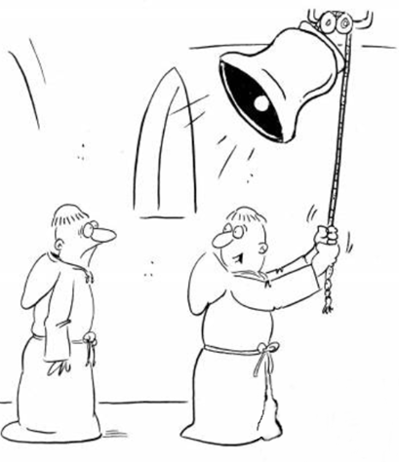
Coherent control of transient dynamics
Zero-energy ground-state is a guaranteed control point
Question: How do you stop a bell ringing ?
  The “ringing bell” could be excitations of a molecule, a crystal, a device, …
Notes:
18

Slide 19
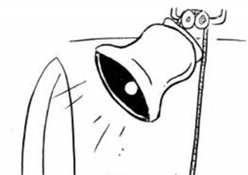

Coherent control of transient dynamics
Question: How do you stop a bell ringing ?
Answer: You hit it ! ( … in a very controlled and precise way)
Control field generator
System
Notes:
19

Slide 20
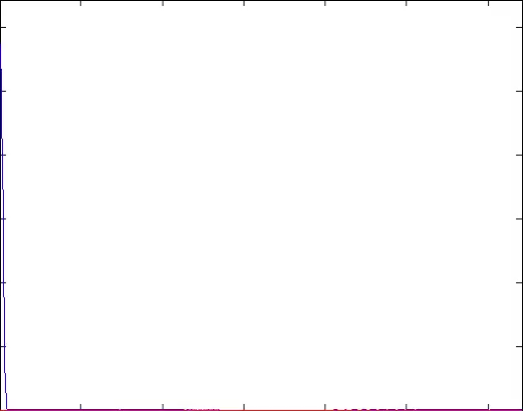
Controlled single-photon zero cavity ring-down
L_{C}
Control pulse can result in exact cancellation of energy density in resonator
Time
Photon energy density, |Ψ(x,t)|²
t²r+r³ = (t²+r²)r=r
itr²-itr²=0
-r²
-itr
-t²
0
200
400
600
800
1000
1200
Position, x(μm)
it
Identical lossless dielectric mirrors m_{r} with field reflectivity r and field transmission t
Control pulse with optimal amplitude and phase shift to eliminate photon energy density in resonator
Formal control methods replaced by intuitive ray-tracing of resonant part of photon field
-r
τ₀ = 5 fs
τ_{p} = 80 fs
τ_{RT}= 150 fs
τ_{Q} = 153 fs
m_{r}
m_{r}
1
Incident photon pulse energy density
Space
Notes:
20

Slide 21
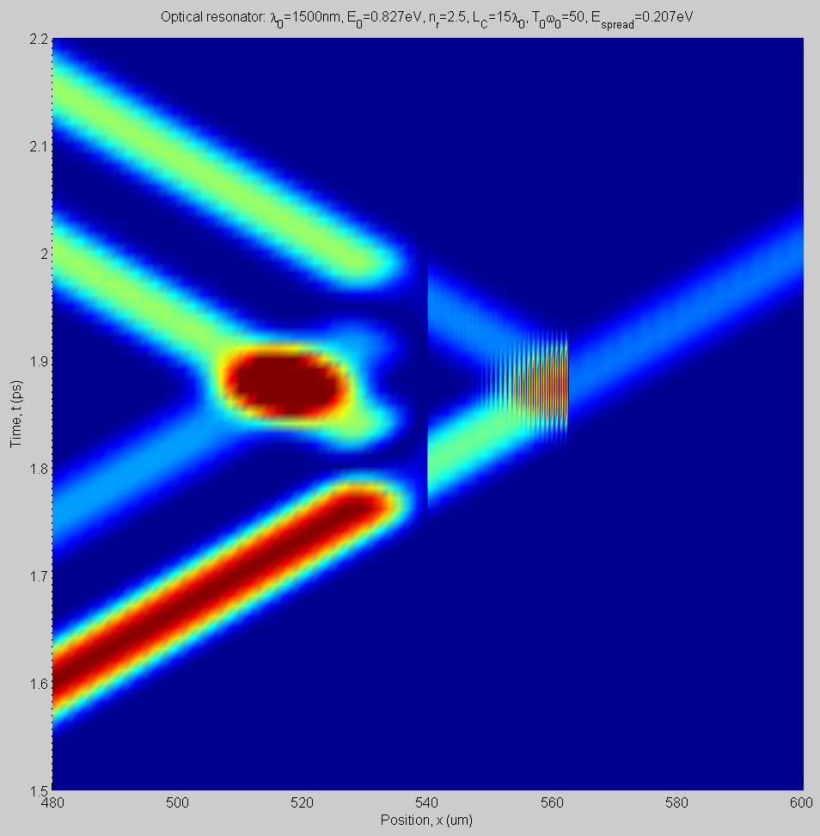
Controlled single-photon zero cavity ring-down
Dual reflected photon pulse energy density
Transmitted single-photon pulse energy density (cancellation of ring-down)
Time
Incident control photon pulse and lead pulse energy density
τ₀ = 5 fs
τ_{p} = 80 fs
τ_{RT}= 150 fs
τ_{Q} = 153 fs
Spatial extent of Fabry-Perot resonator L_{C}=15λ₀
Space

Slide 22
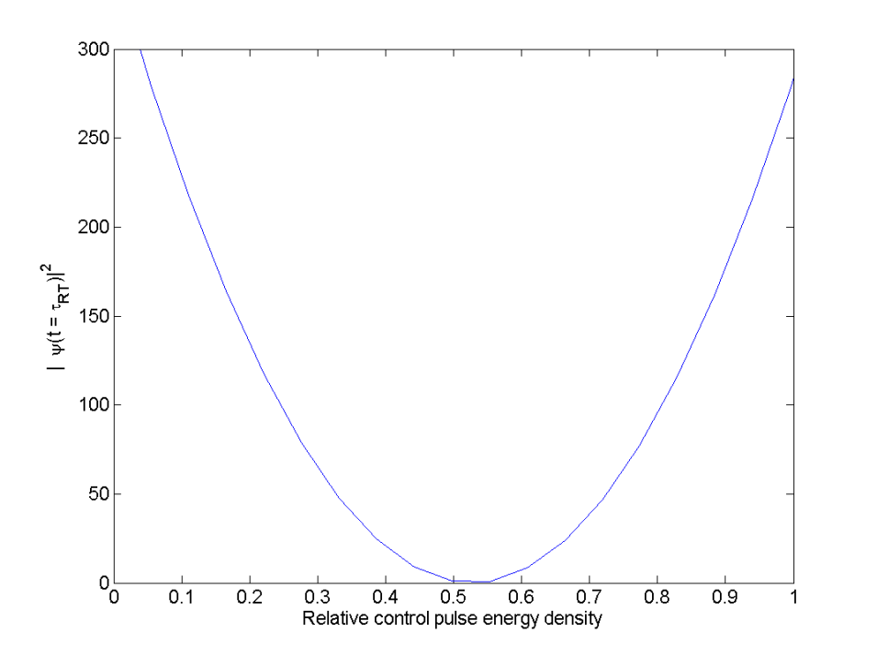
Resonator energy density output as function of control pulse energy density
Locally convex resonator energy density output as function of control pulse energy density
single_photon_lead_plus_control_amp_var2.m
Optimal single-pulse output with no ring-down signal at t=τ_{RT} only when control energy density relative to lead pulse has this value
No ring-down on this line
Single pulse output with no ring-down only when control energy density has this value
τ₀ =5fs
τ_{p} =80fs
τ_{RT}=150fs
τ_{Q} =153fs
Ring-down

Slide 23
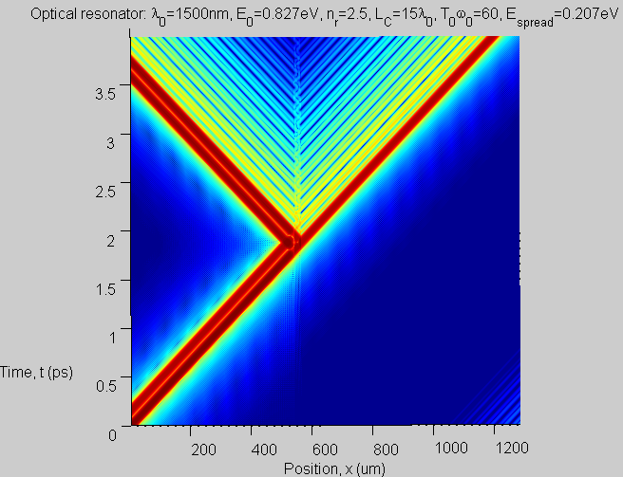
Coherent control of single-photon resonator output pulse using control pulse
Better than 1:10⁴ cancellation using simple control pulse protocol
Cancellation of residue requires better control pulse match to Fabry-Perot transfer function or slower (smaller bandwidth) operation
Single transmitted photon energy density pulse amplitude t²
Dual reflected photon pulse energy density
Log₁₀ color scale shows photon energy density 10⁻⁴ smaller than lead pulse. Formal optimization methods can reduce this to 10⁻²⁵
Incident lead photon pulse and control pulse energy density
τ₀ =5fs
τ_{p} =80fs
τ_{RT}=150fs
τ_{Q} =153fs

Slide 24
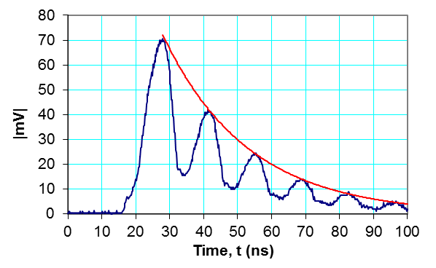
Experimental validation using Fabry-Perot resonator in waveguide
No control pulse
Delay
τ_{RT}+τ_{π}
Attenuator
Waveguide Fabry-Perot resonator
To high-speed oscilloscope
High-speed switch
τ_{Q}, τ_{RT}
splitter
combiner
DBR
DBR
Synthesizer frequency f₀
f₀ = 8 GHz, τ_{Coh} = 1 s, τ₀ = 125 ps, τ_{p} = 7 ns, τ_{RT} = 13.7 ns, τ_{Q} = 12.5 ns
fileD7.xlm
With single control pulse
Coherent control of resonator short output pulse using single short control pulse
Short electromagnetic pulse of width τ_{p}=10 ns < τ_{RT}, τ_{Q}
Round-trip time in resonator τ_{RT}=13.7 ns
Resonator Q=633 corresponds to τ_{Q}=12.5 ns (red curve)
Measured transmitted electromagnetic signal in time-domain |mV| into 50 Ω
fileD5.xlm

Slide 25
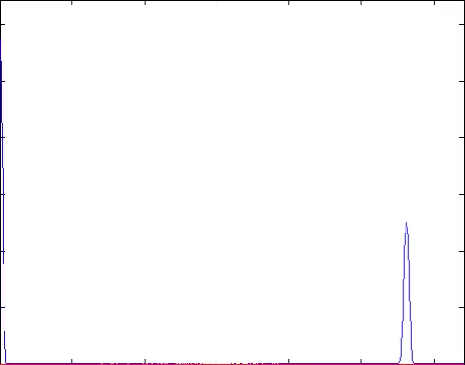
Coherent control of single-photon resonator output pulse using one backward control pulse
τ₀ = 5 fs
τ_{p} = 80 fs
τ_{RT}= 150 fs
τ_{Q} = 153 fs
L_{C}
Control pulse can result in exact cancellation of energy density in resonator
Time
Photon energy density, |Ψ(x,t)|²
-itr+itr = 0
-t²-r²=-1
0
200
400
600
800
1000
1200
-r
it
Position, x(μm)
r
Lead pulse and one backward propagating control pulse incident on resonator
Single pulse transmitted and single pulse reflected with no ring-down
m_{r}
m_{r}
1
Incident photon pulse energy density
Space

Slide 26
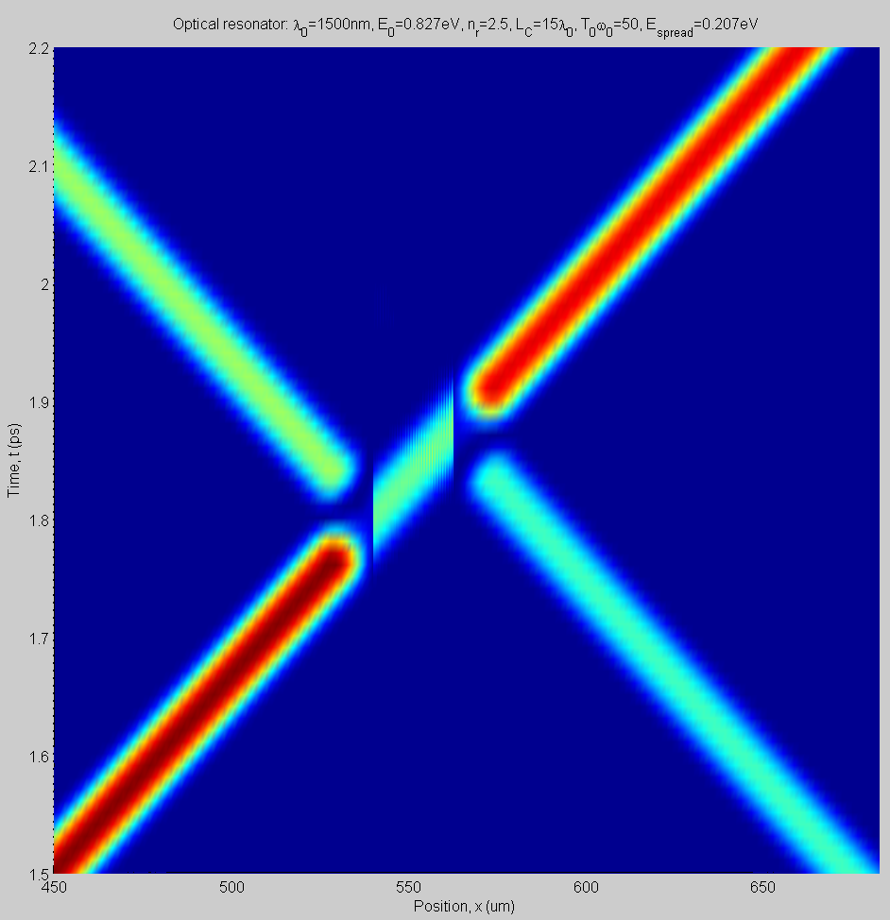
Coherent control of single-photon resonator output pulse using one backward control pulse
Transmitted photon energy density as single pulse
Single reflected photon pulse energy density
τ₀ = 5 fs
τ_{p} = 80 fs
τ_{RT}= 150 fs
τ_{Q} = 153 fs
Time
Spatial extent of Fabry-Perot resonator L_{C}=15λ₀
Backward propagating control pulse
Incident lead photon pulse energy density
Space

Slide 27
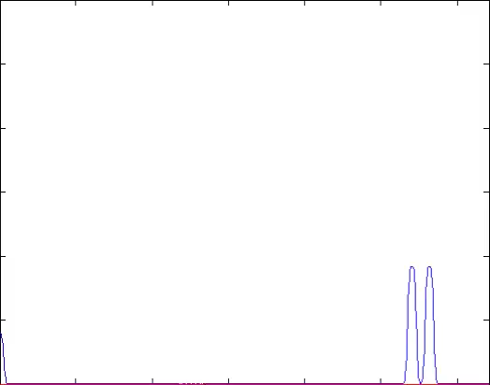
Coherent control of single-photon resonator output pulse using two backward control pulses
L_{C}
Time
ir/t-ir/t
=0
Photon energy density, |Ψ(x,t)|²
-1-r²/t²=-1/t²
-r+r=0
it+ir²/t=i/t
r/t²
-itr
r²/t²
1
0
200
400
600
800
1000
1200
Incident photon pulse energy density
-r/t²
Position, x(μm)
Lead pulse and two backward propagating control pulses incident on resonator
Dual pulse transmitted with no ring-down
m_{r}
m_{r}
Space

Slide 28
Coherent control of single-photon resonator output pulse using two backward control pulses
Single reflected photon pulse energy density
Two transmitted photon energy density pulses
No reflection at zeroth and first RT
τ₀ = 5 fs
τ_{p} = 80 fs
τ_{RT}= 150 fs
τ_{Q} = 153 fs
Time
Spatial extent of Fabry-Perot resonator L_{C}=15λ₀
Backward propagating control pulses
Incident lead photon pulse energy density
Space

Slide 29
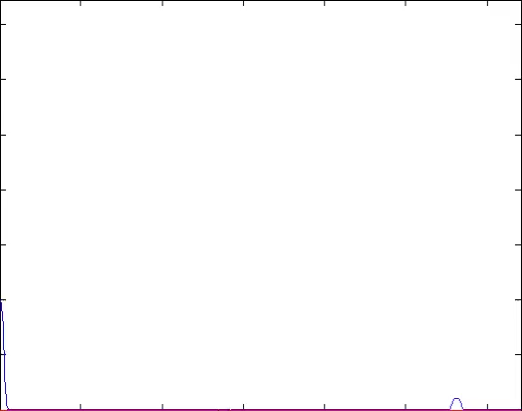
Coherent control using one forward and one backward control pulse (or a very small pulse can control two large pulses)
L_{C}
Time
Photon energy density, |Ψ(x,t)|²
t⁴/r+t²r+r
it-it=0
-1
-it³/r-itr
t²-t²=0
0
200
400
600
800
1000
1200
-r
i/t
-t²/r
Position, x(μm)
Lead pulse and one forward and one small backward propagating control pulse incident on resonator
Two pulses reflected with no ring-down
Note small energy in backward propagating control pulse
m_{r}
m_{r}
1
Incident photon pulse energy density
Space

Slide 30
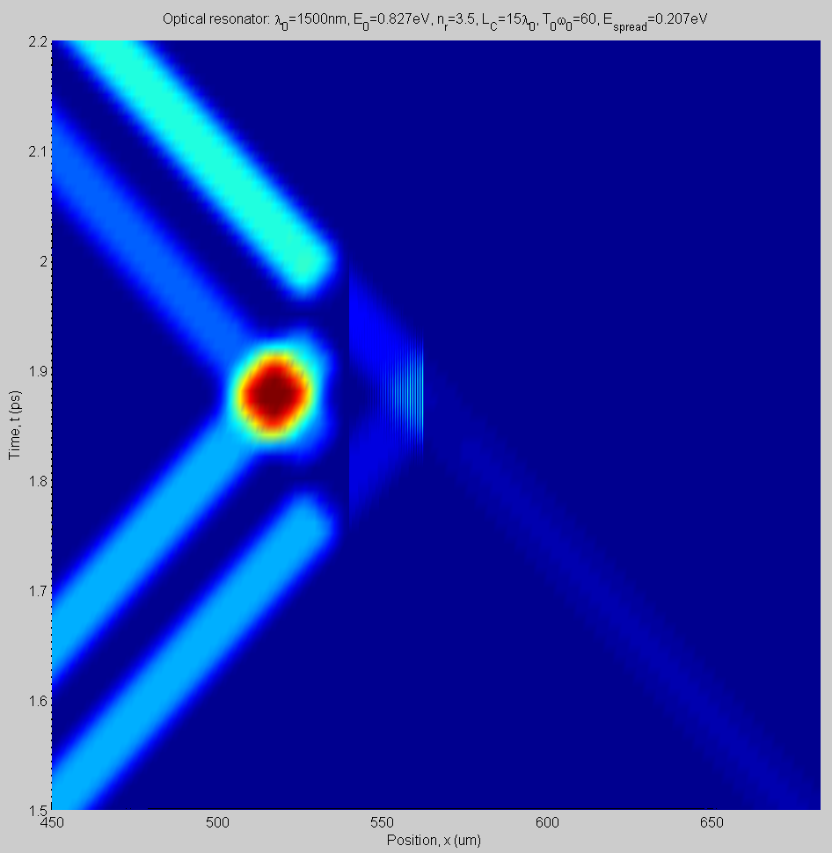
Coherent control using one forward and one backward control pulse
Reflected photon energy density pulses
No Transmitted photon energy density
τ₀ = 5 fs
τ_{p} = 80 fs
τ_{RT}= 150 fs
τ_{Q} = 153 fs
Time
Forward propagating control pulse
Spatial extent of Fabry-Perot resonator L_{C}=15λ₀
Backward propagating control pulse
Incident lead photon pulse energy density
Space

Slide 31
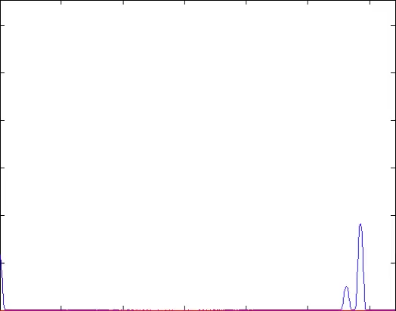
Coherent control using one forward and two backward control pulses
L_{C}
Time
it/r-it/r =0
Photon energy density, |Ψ(x,t)|²
-t²/r²-1
-t²/r+t²r=0
it/r²
-1/r
-it³/r-itr=-it/r
t²/r²
t²-t²=0
0
200
400
600
800
1000
1200
-r
i/t
-t²/r
Position, x(μm)
Lead pulse and one forward and two backward propagating control pulses incident on resonator
Single pulse transmitted and single pulse reflected with no ring-down
m_{r}
m_{r}
1
Incident photon pulse energy density
Space

Slide 32
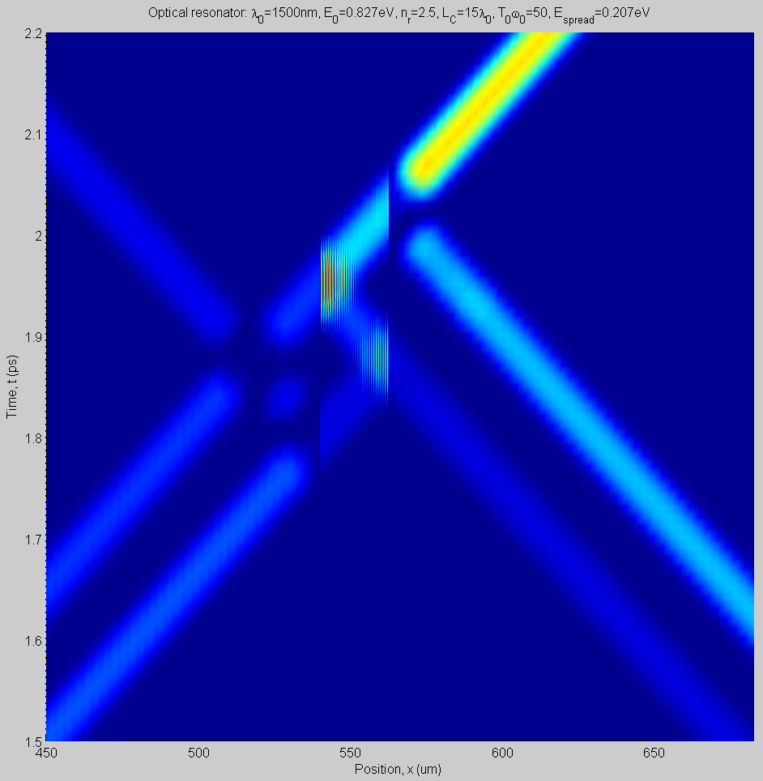
Coherent control using one forward and two backward control pulses
Reflected photon energy density pulse
Transmitted photon energy density
τ₀ = 5 fs
τ_{p} = 80 fs
τ_{RT}= 150 fs
τ_{Q} = 153 fs
Time
Forward propagating control pulse
Spatial extent of Fabry-Perot resonator L_{C}=15λ₀
Backward propagating control pulses
Incident lead photon pulse energy density
Space

Slide 33
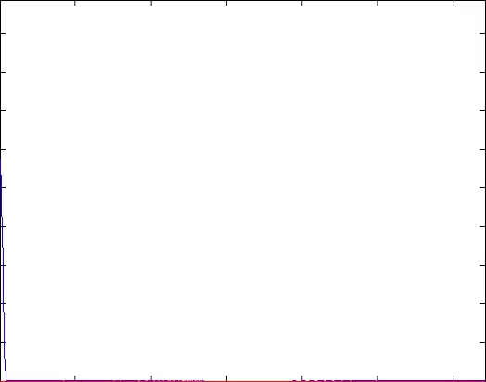
Coherent control of single-photon resonator output pulses using multiple control pulses
Lead pulse and three control pulses incident on resonator
Three identical pulses transmitted and dual pulse reflected with no ring-down
Photon energy density, |Ψ(x,t)|²
τ₀ =5fs
τ_{p} =80fs
τ_{RT}=150fs
τ_{Q} =153fs
0
200
400
600
800
1000
1200
Position, x(μm)

Slide 34
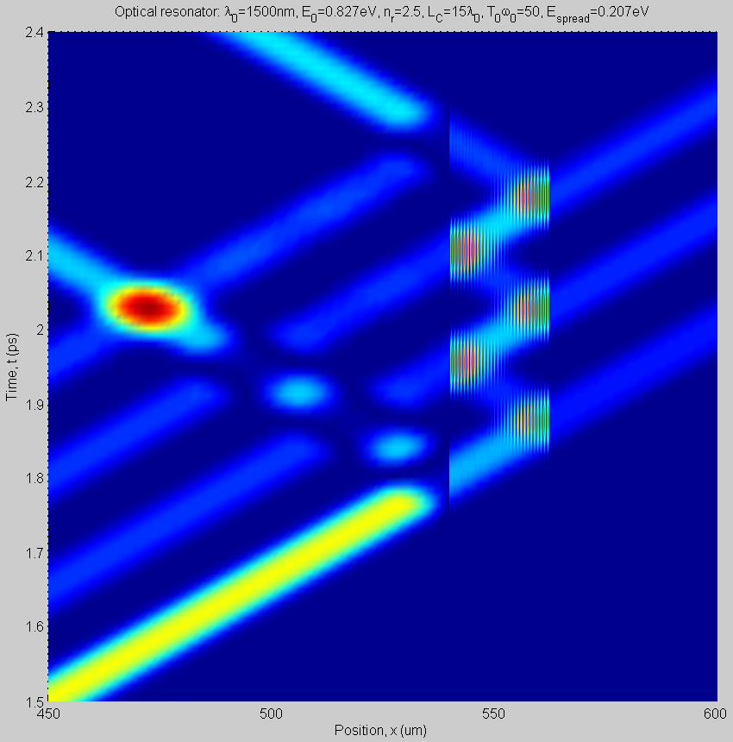
Coherent control of single-photon resonator output pulse using three control pulses
Dual reflected photon pulse energy density
No reflection at first and second RT
Transmitted photon energy density in three identical pulses
Time
Incident lead photon pulse and multiple control pulse energy density
Spatial extent of Fabry-Perot resonator L_{C}=15λ₀
τ₀ =5fs
τ_{p} =80fs
τ_{RT}=150fs
τ_{Q} =153fs
Space

Slide 35
Coherent control of single-photon resonator output pulse using three control pulses
itr²-itr²=0
Control pulse results in cancellation of energy density in resonator
r³+t²r
-itr
-t²
Control pulse with phase shift to eliminate photon energy density in resonator
-r²
No reflection
it
Three identical transmitted photon energy density pulses each of amplitude -t²
-itr
-t²
Time
t²
it
No reflection
-itr
-t²
Control pulses to eliminate photon energy density reflection
t²
it
-r
1
Identical lossless dielectric mirrors with field reflectivity r and field transmission t
τ₀ =5fs
τ_{p} =80fs
τ_{RT}=150fs
τ_{Q} =153fs
Incident photon pulse energy density
Space

Slide 36
Geometric series using coherent control pulses to confine photon energy density in resonator
Useful relations: t²+r²=1, t²/r²=1/r²-1
-t²/r⁶+ t²/r⁶=0
it/r⁴+it³/r⁶=it/r⁶
0
-t²/r⁷
Photon field in resonator is geometric series in e^{iφ}/r that sums to the N-1 value as t(1+e^{iφ}/r+e^{i2φ}/r²+e^{i3φ}/r³ + …)=
t(1-(e^{iφ}/r)^{N})/(1-(e^{iφ}/r))
where phase per round-trip is 2φ=2πω/Δω and spacing between resonances is Δω=πc/L_{C}n_{r}. The series does not converge because r<1 and so |e^{iφ}/r| >1.
-it/r³-it³/r⁵=-it/r⁵
t²/r⁶
-t²/r⁴+t²/r⁴=0
it/r²+it³/r⁴=it/r⁴
0
-t²/r⁵
-it/r-it³/r³=-it/r³
t²/r⁴
0
Time
it+it³/r²=it/r²
0
-t²/r³
Control pulse to eliminate photon energy density reflection
-itr-it³/r=-it/r
t²/r²
0
it
-t²/r
Control pulse to eliminate photon energy density reflection
-r
1
Identical lossless dielectric mirrors with field reflectivity r and field transmission t
Incident photon pulse energy density
Space

Slide 37
Coherent control
L_{C}
L_{C}
Differential
output
off-state
Differential
output
inverted-state
Time
Time
-itr+itr=0
r+t²/r=r(t²+r²)=r
-it+it=0
r²+t²=1
r
-r
r
-it³/r-itr=-it(t²+r²)/r=-it/r
-it
-1
-1
itr-itr=0
t²-t²=0
-r²-t²=-1
-r
-t²/r
-r
r
it
it
m_{r}
m_{r}
m_{r}
m_{r}
1
1
Space
Space

Slide 38
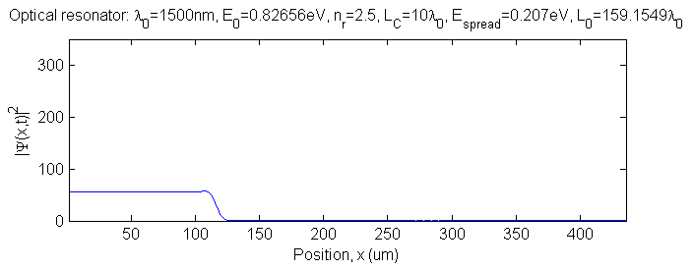
Markovianity measure D(t) of single photon
System (defined as some region of domain) coupled to continuum at ±∞
Unitary evolution of initial state eventually dissipates
Define spatial region A in domain and consider freely propagating photon pulse through this region
Under these conditions one may expect any measure of Markovianity in region A to indicate Markovian behavior
  Information leaks out of region A as the photon energy density decays into the continuum
Rectangular photon pulse ψ₁(x,t) propagating in free-space from left to right
Region A

Slide 39
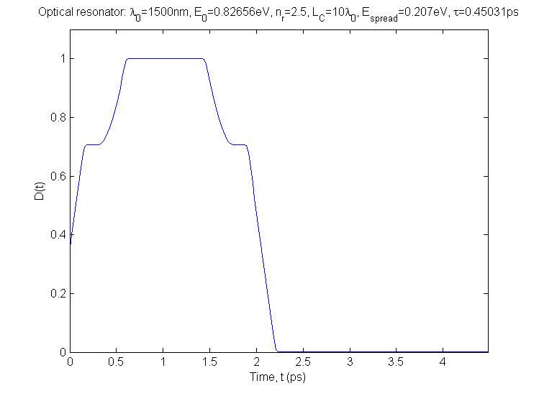
Hilbert-Schmidt measure D(t) and Markovianity
Two initially non-interacting (non-overlapping) photon pulses with unitary evolution and initial states such that ψ₂(x, t) = ψ₁(x, t+τ_{Μ}) for fixed delay τ_{Μ} have Hilbert-Schmidt measure in spatial region A given by (Lorenzo Campos Venuti)
The system is considered Markovian if initial states ψ₁(x, t) and ψ₂(x, t) are both in spatial region A and D(t) subsequently decreases monotonically with time
Example: non-interacting rectangular photon pulse propagating in free-space
Rectangular photon pulse ψ₁(x,t) and time shifted pulse ψ₂(x,t) = ψ₁(x,t+τ_{M}) both freely propagating in region A such that normalized measure D(t)=1
Monotonic decrease of D(t) as ψ₁(x,t) and ψ₂(x,t) leave and information leaks out of region A

Slide 40
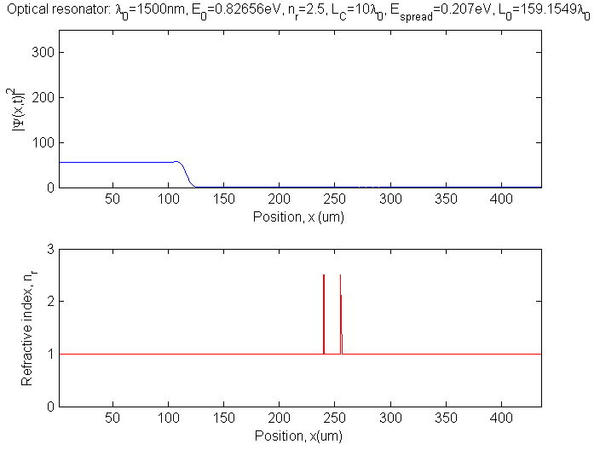
Hilbert-Schmidt measure D(t) of photon interacting with Fabry-Perot dielectric resonator
  A (blue curve) left of dielectric resonator with some energy density flow into region
  B (black curve) which is in dielectric resonator with energy density flow into region
  C (red curve) to right of dielectric resonator
  Note: Extent of region in domain and definition of system, subsystem, bath, etc., is arbitrary
Rectangular photon pulse propagating from left to right
Dielectric resonator
Region A
Region B
Region C

Slide 41
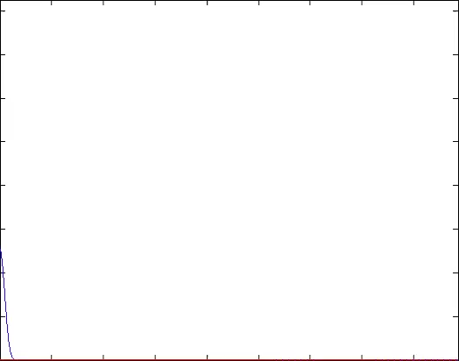
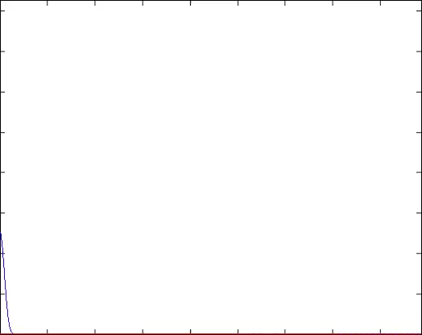
Hilbert-Schmidt measure D(t) of photon interacting with Fabry-Perot dielectric resonator
Incident pulse-width τ_{p} < τ_{RT}, τ_{Q}
Single incident pulse produces multiple output pulses (ring-down) spaced at cavity round-trip time and of decreasing energy density as resonator decay
No control pulse
With single control pulse
Markovianity.tmp0.avi
Markovianity.tmp1.avi
Photon energy density, |Ψ(x,t)|²
Photon energy density, |Ψ(x,t)|²
0
100
200
300
400
0
100
200
300
400
Position, x(μm)
Position, x(μm)
τ₀ =5fs
τ_{RT}=150fs
τ_{Q} =153fs
τ_{M} =225fs
Position of FP resonator

Slide 42
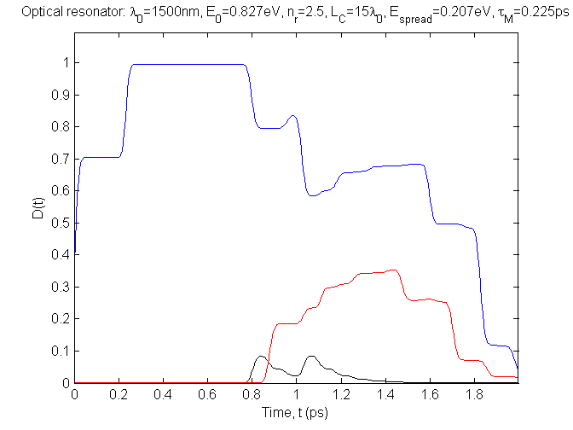
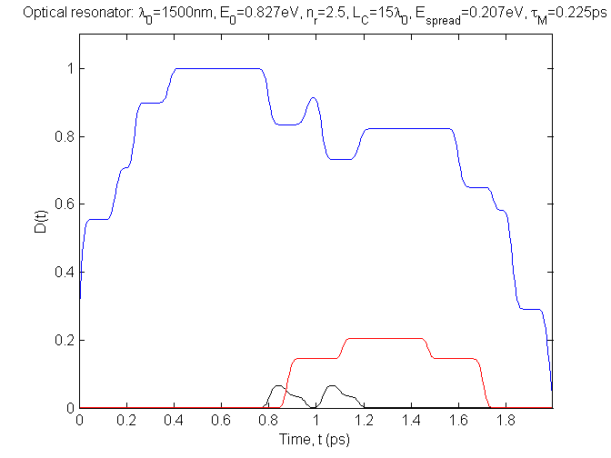
Hilbert-Schmidt measure D(t) of photon interacting with Fabry-Perot dielectric resonator
  A (blue curve) left of dielectric resonator with some energy density flow into region
  B (black curve) which is in dielectric resonator with energy density flow into region
  C (red curve) to right of dielectric resonator
No control pulse
With single control pulse at τ = τ_{RT}
Mamp0000T030M45.tif
Mamp0525T030M45.tif
Non-Markovian
Non-Markovian
Left of dielectric resonator
Transmitted output to right of dielectric resonator
Control pulse ensures simple Markovian transmitted output
A
Dielectric resonator
C
B
Photon pulse ψ₁(x,t) and time-shifted pulse ψ₂(x,t) = ψ₁(x,t+τ_{Μ}) both initially propagating freely in region A
Non-monotonic decrease of D(t) because energy density is reflected at resonator and energy density is stored and subsequently released from resonant cavity
τ₀ =5fs
τ_{RT}=150fs
τ_{Q} =153fs
τ_{M} =225fs

Slide 43
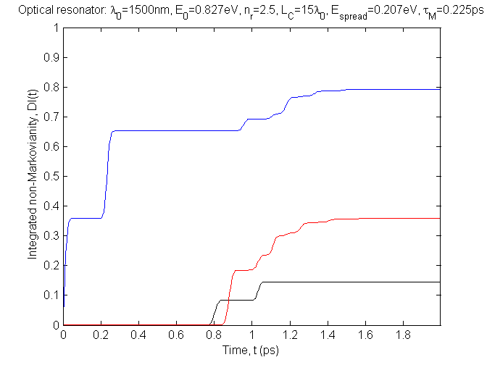
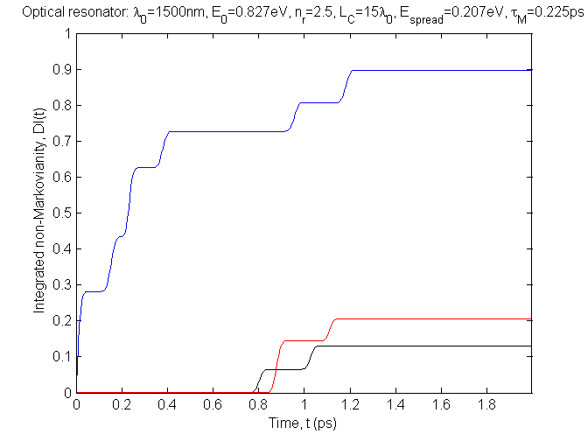
Integrated non-Markovianity, DI(t)=Σ_{i}(ΔD(t_{i})|_{positive})
No control pulse
With single control pulse at τ = τ_{RT}
Mamp0000T030M45.tif
Mamp0525T030M45.tif
Non-Markovian
Non-Markovian
Left of dielectric resonator
Transmitted output to right of dielectric resonator
Dielectric resonator
A
C
B
Mamp0000T030M45DI.tif
Mamp0525T030M45DI.tif
Non-Markovian
Non-Markovian
Continued increase limited by pulse leaving domain
τ₀ =5fs
τ_{RT}=150fs
τ_{Q} =153fs
τ_{M} =225fs

Slide 44
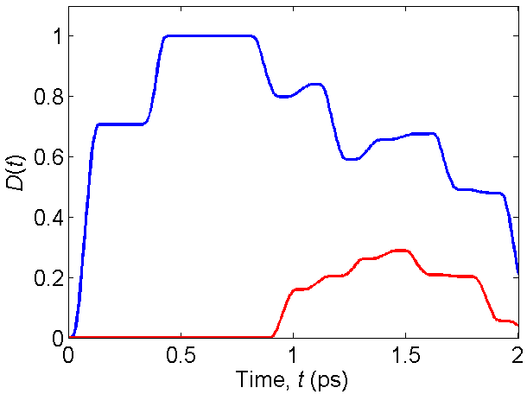
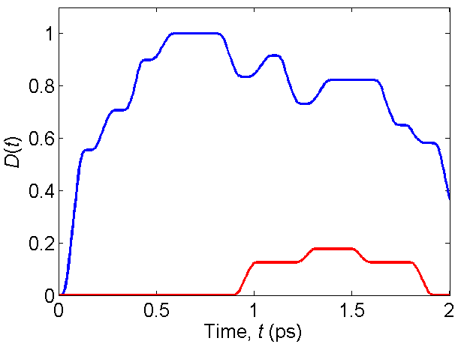
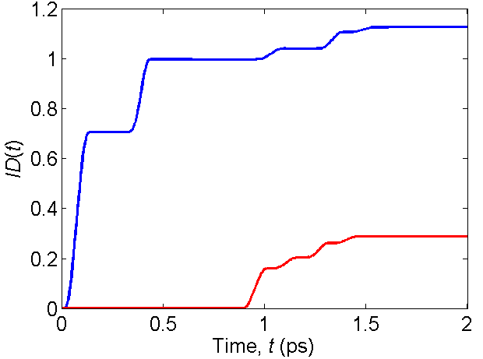
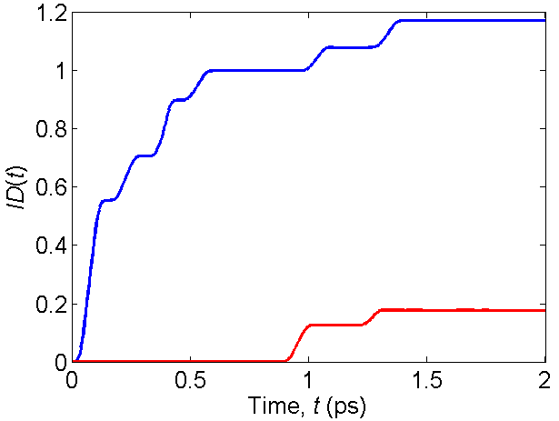
Integrated non-Markovianity, DI(t)=Σ_{i}(ΔD(t_{i})|_{positive})
No control pulse
With single control pulse at τ = τ_{RT}
(a)
(b)
Left of resonator
Transmitted pure Markovian pulse to right of resonator
A
Non-Markovianity to
right of resonator
A
C
C
(c)
A
(d)
A
Non-Markovianity to right of resonator
Transmitted pure Markovian pulse to right of resonator
C
C
τ₀ =5fs
τ_{RT}=150fs
τ_{Q} =153fs
τ_{M} =150fs

Slide 45
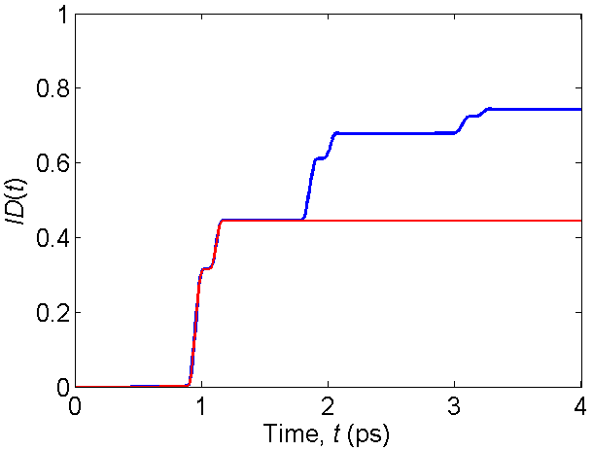
Integrated non-Markovianity, DI(t)=Σ_{i}(ΔD(t_{i})|_{positive})
No control pulse
Cavity length L=120 x λ₀
Sub-space B’ is left-side half-cavity of length L/2
B'
B
τ₀ =5fs
τ_{RT}=150fs
τ_{Q} =153fs
τ_{M} =150fs

Slide 46
Summary: Coherent control of single-photon energy density in a resonator
  Photonic resonator with lossless dielectric mirrors driven by phase-coherent source is open system coupled to continuum that evolves with unitary dynamics
    Photon wave function, Ψ(x,t), describes single-photon energy density, U(x,t)=|Ψ(x,t)|²
    Multiple resonator round-trip times, τ_{RT}, required to build-up steady-state behavior
    Steady-state behavior evolves exponentially during characteristic resonator time, τ_{Q}
Transient behavior controlled by incident waveform
  Non-Markovian dynamics because mirror reflections and energy stored in resonator
  Can eliminate all energy density in resonator in less than one round-trip time, τ_{RT}
  Can control exact number of identical transmitted and reflected pulses at multiples of round-trip time, τ_{RT}
  Can use control to pass long pulses, τ_{P}>τ_{RT}, through resonator
  Control of transient behavior is also control of Markovianity (and hence information flow)
    Non-Markovianity may be viewed as resource for quantum information processing
  Natural time scales are {τ₀, τ_{RT}, τ_{Q} } < τ_{Coh}
  Resource for manipulation of single-photon quantum states
  Use waveform as sensor probe of resonant structures (inverse problem)

Slide 47
Coherent control of single-photon transient dynamics in a Fabry-Perot resonator
A.F.J. Levi, L. Campos Venuti, T. Albash, and S. Haas, “Coherent control of non-Markovian photon resonator dynamics” Phys. Rev. A (2014)
OBJECTIVE:
Controlled single-photon zero cavity ring-down
Demonstrate coherent quantum control of single-photon dynamics in an optical storage device
Apply techniques developed to demonstrate control of non-Markovianity
Dual reflected photon pulse energy density
Transmitted single-photon pulse energy density (cancellation of ring-down)
APPROACH
Use photon pulse injected into Fabry-Perot resonator as model system coupled to continuum and simulate in space-time domain
Exert precise control on photon dynamics using coherent control pulses and intuitive resonant control protocol
Use L. Campos Venuti’s computationally-efficient measure of non-Markovianity: N. Chancellor, C. Petri, L. Campos Venuti, A.F.J. Levi, and S. Haas, Phys. Rev. A (2014)
Time
Incident control photon pulse and lead pulse energy density
Spatial extent of Fabry-Perot resonator L_{C}=15λ₀
τ₀ = 5 fs
τ_{p} = 80 fs
τ_{RT}= 150 fs
τ_{Q} = 153 fs
Space
Multiple reflected photon energy density pulses (ring-down)
Multiple transmitted photon energy density pulses (ring-down)
ACCOMPLISHMENTS: Successfully demonstrated control of single-photon transient dynamics in Fabry-Perot resonator
and measure of non-Markovianty
Uncontrolled single-photon cavity ring-down
A first step to exploitation of non-Markovian transient photon dynamics as a resource in coherent quantum systems
Established methodology and techniques for further study
Time
ID(t)
Spatial extent of Fabry-Perot resonator that stores and releases photon energy density is L_{C}=15λ₀
τ₀ = 5 fs
τ_{p} = 80 fs
τ_{RT}= 150 fs
τ_{Q} = 153 fs
Incident photon pulse energy density
Space

Slide 48
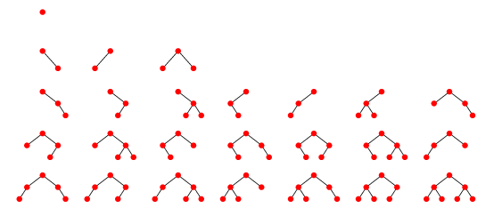
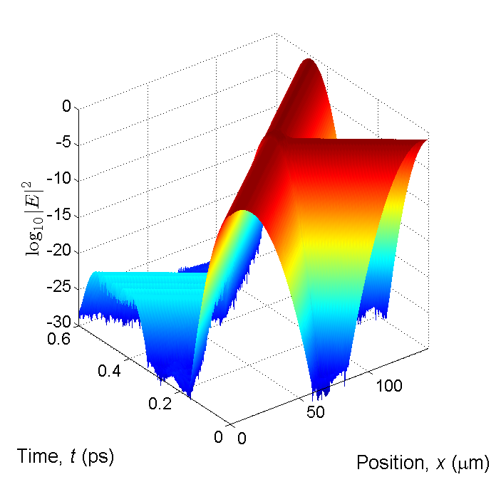
Coherent control of single-photon transient dynamics for logic
A. Abouzaid, F. Wang, S. Gupta, and A.F.J. Levi
OBJECTIVE:
ACCOMPLISHMENTS: Enumerator discovers all feasible boolean logic tree-structures
Demonstrate coherent quantum control of single-photon dynamics may be applied to boolean logic and perform exhaustive search in minimal linear device design sub-space for all feasible logic operations
High-level simulator checks if feasible solution exists (to depth k in tree-structure) for a designated boolean function
If no feasible solution is found by the high-level simulator, then that logic function cannot be implemented using only linear components connected in a tree-structure
APPROACH
Basic (minimal) device building block is symmetric 50:50 single-photon beam-splitter
Formally enumerate all tree structures up to depth of k in which tree-structures have no feedback and no re-convergent fan-out
Combine two phase shifters/Modulators with one beam splitter to reduce the enumeration complexity
Use physical model to validate results
For any n-input configuration created using only linear components connected in a tree-structure, if a feasible solution exists for a given boolean function in the high level simulation, then the boolean function is implementable in the low-level simulator
ACCOMPLISHMENTS: Exact suppression of reflection at beam-splitter using control pulse
ACCOMPLISHMENTS: Successfully enumerated all boolean logic using minimal components and constraints
Optical pulse contains broad spectrum of frequency components that interact with symmetric 50:50 single-photon beam-splitter
Optimal control pulse to suppress reflection requires search for coherent single-photon phase and amplitude field parameters
Example of non-optimal suppression of reflection (10⁻²⁵)
Constrained to single-photon, beam-splitter, amplitude modulator, phase shifter, and tree-structure
Components indicate events, i.e. an interaction between pulses and a particular component at some point in time and space
Successfully demonstrated NAND and so complete for boolean logic
Also, NOT, OR, XOR, XNOR, and multiplexing
AND and NOR are not feasible
Reshaping, retiming, and re-amplifying (3R) output may be achieved for classical light using a saturable absorber, however, the single-photon version of 3R is unknown

Slide 49
Acknowledgements
Walter Unglaub
Amine Abouzaid
Lorenzo Campos Venuti
Stephan Haas
Tameem Albash
Fangzhou Wang
Sandeep Gupta
A.F.J. Levi, L. Campos Venuti, T. Albash, and S. Haas,
“Coherent control of non-Markovian photon resonator dynamics”
Phys. Rev. A 90, 022119 (2014)

